Slide 1
PROPOSED AMENDMENTS TO DOMESTIC VIOLENCE LAW
Gender Research & Advocacy Project
LEGAL ASSISTANCE CENTRE
2021

Slide 2
Background to proposed amendments
The amendments are based primarily on the study of the implementation of the Combating of DV Act by the Legal Assistance Centre: Seeking Safety (2012).
The Ministry of Justice invited public input on amendments to the DV Act and commissioned LAC to provide a working draft based on this input (2016).

Slide 3
Proposed amendments
Definition of “domestic relationship”: Include children, and persons with illnesses or disabilities, and their primary caretakers.
the persons being cared for are in positions of vulnerability and could be subject to abuse
there are indications that some primary caretakers for such persons have engaged in abusive behaviours

Slide 4
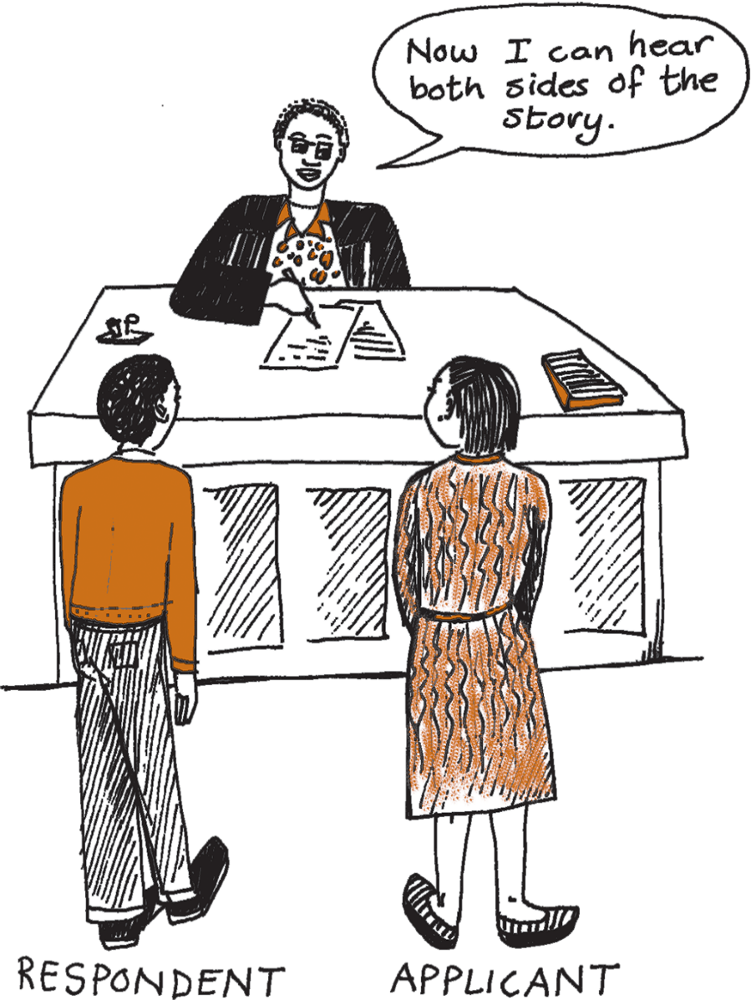
Proposed amendments
Procedural changes: Simplify procedure for notice of court hearing to consider making interim protection order into final protection order.
This part of the law currently involves paperwork that has proved particularly confusing to respondents. The procedure will be simplified to make sure that both parties get clear notice to come to court to tell their side of the story.

Slide 5
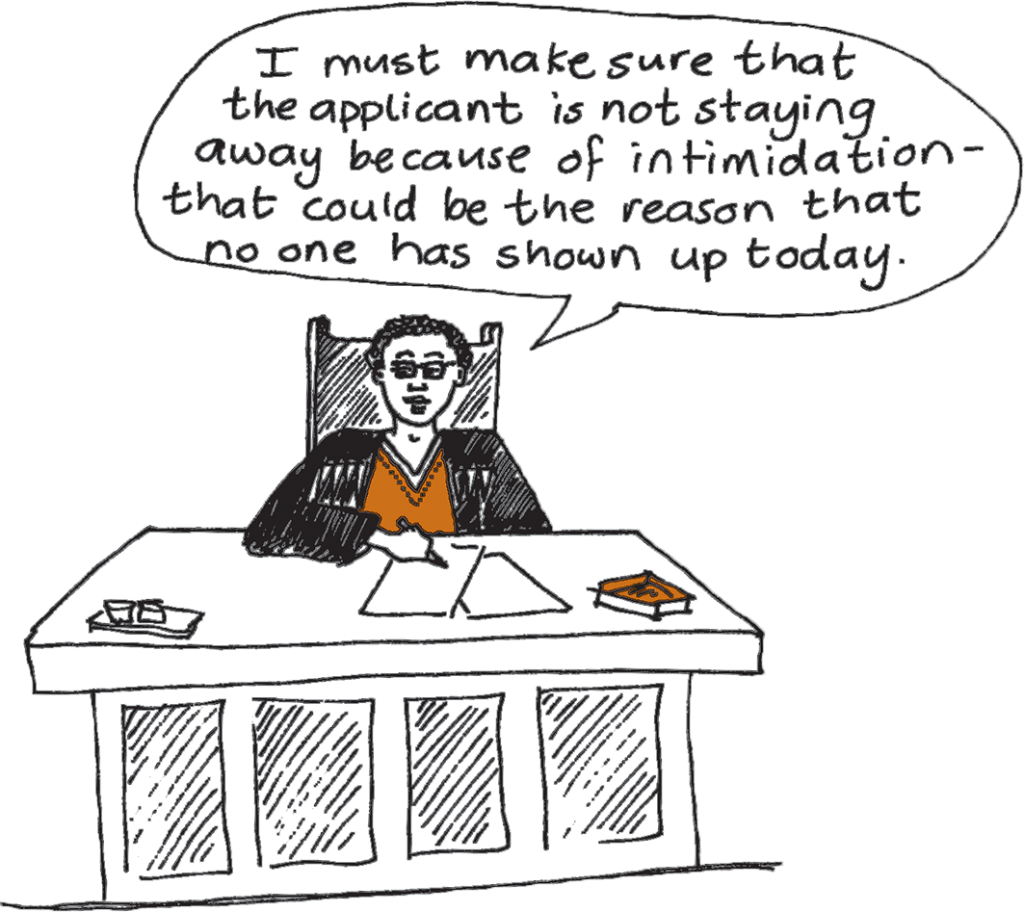
Proposed amendments
Protection against intimidation: Strengthen monitoring provisions to check for intimidation if applicant does not return to court after getting an interim order.
Add involvement of social worker and clerk of court in addition to police, and require feedback to magistrate who issued interim order

Slide 6
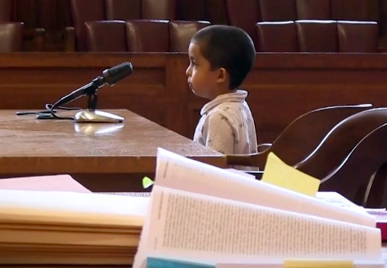
Proposed amendments
Reduce trauma in court: Apply special arrangements for vulnerable witnesses to protection order proceedings.
rearranging the courtroom
using one-way screens or closed circuit TV
support persons to comfort the victim
use of intermediaries to restate questions
other steps that may be “expedient and desirable”.
Such special arrangements are currently only available in criminal proceedings about domestic violence.

Slide 7
Proposed amendments
Involve social workers: Make provision for social worker reports for court’s guidance if necessary.
Social workers can interview people such as extended family members or community members to find out more about the family situation. This can help the court to understand the dynamics and make a well-informed decision.

Slide 8
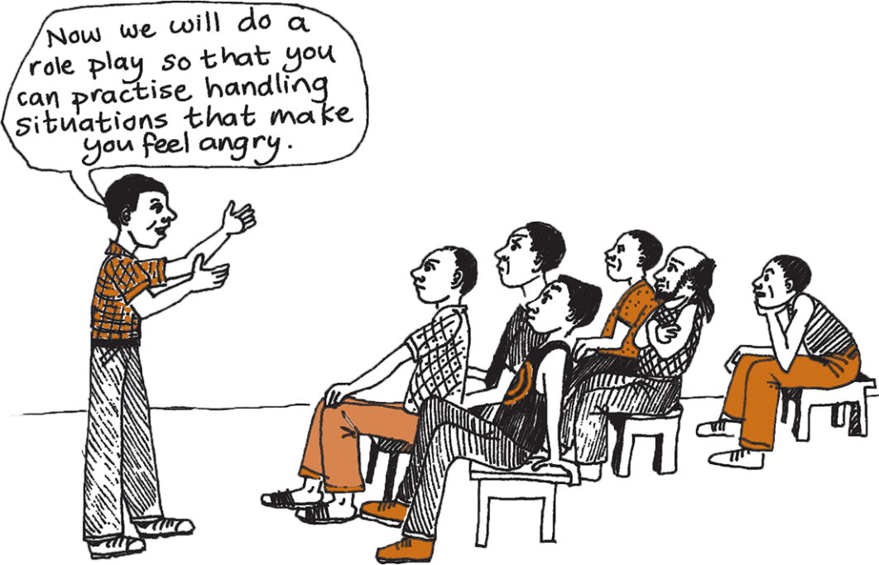
Proposed amendments
Help perpetrators change: Make it possible for the court to refer perpetrators to counselling or treatment programmes.
permissible only if the victim has no reasonable objections
order may not require a victim to participate in any such programme together with the abuser if the victim is unwilling
court can make this kind of order only after hearing abuser’s views

Slide 9
Proposed amendments
Quicker response: Provide for temporary emergency protection orders via police, issued by court by telephone, email or fax.
Victim makes sworn statement at police station
Police contact magistrate
Magistrate can approve an emergency protection order
If done over the telephone, station commander will write it down
Order will then be served on abuser in the usual manner

Slide 10
Proposed amendments
Other amendments: There are a number of other amendments that are primarily technical in nature, or intended to clarify the current law.
LAC has also proposed simplified forms that have been pre-tested with magistrates and social workers. Improved forms would make the law more accessible.

Slide 11
Missing amendment
Non-discrimination: It has been proposed to amend the law to allow couples in same-sex relationships to access the law’s protections against domestic violence:
(b) they, being of different sexes, live or have lived together in a relationship in the nature of marriage…
(f) they, being of different sexes, are or were in an actual or a perceived intimate or romantic relationship

Slide 12
Arguments in favour of the missing amendment
All persons deserve protection from domestic violence, regardless of their sexual orientation.
Including same-sex couples would remove unfair discrimination. Failure to make this amendment might violate the constitutional right to equality before the law, the right to dignity and the right to protection against cruel, inhuman or degrading treatment.

Slide 13
Myths about the missing amendment
Giving same-sex couples access to protection against domestic violence would NOT lead to same-sex marriage.
The law already covers both married and unmarried opposite-sex couples.
This law is not about a law about marriage.

Slide 14
Myths about the missing amendment
Protecting same-sex couples against domestic violence would NOT imply approval of same-sex relationships.
The law protects unmarried opposite-sex couples, but no one assumes that this is the same as condoning sex before marriage.
Rape involving perpetrators and victims of the same sex is already covered by the rape law – why not domestic violence?
Allowing access to the courts to combat violence is not about approval or disapproval of any relationships – it is about combating violence.

